Slide 1


DATA VISUALIZATION
TOPIC:
AIR QUALITY MONITORING AND FORECASTING
BY CHARAN SB
27PG00072
UNDER THE GAIDENCE OF
DR BHANU.KN

Slide 2















THE FUTURE
EARTH/LOCATIONS?

Slide 3



INTRODUCTION
Air pollution has become one of the most pressing global concerns due to its serious impact on human health, the environment, and climate change. Monitoring and predicting air quality is essential for public safety, policy planning, and environmental sustainability
This project aims to perform a comprehensive analysis of air quality using a real-world dataset containing pollutant concentrations and meteorological parameters such as temperature and humidity.
The dataset includes time-stamped measurements of key pollutants PM2.5, PM10, O₃, NO₂, SO₂, CO along with temperature, humidity, and the Air Quality Index (AQI).followed by exploratory visualizations to understand pollutant patterns and relationships.
Linear Regression and Random Forest Regressor models to predict AQI based on pollutant concentrations and weather features. Furthermore, we use Facebook Prophet, a time series forecasting model, to project future AQI trends, enabling proactive environmental planning.
we visualize historical pollutant trends and AQI distribution using multi-line plots, subplots, and pie charts. This gives deeper insight into the temporal dynamics of pollution levels and the proportion of days falling into different AQI categories such as Good, Moderate, and Poor.

Slide 4


Key Insights
Missing data handled smoothly without dropping rows.
Pollutants like PM2.5, NO₂, and O₃ showed significant influence on AQI in pairplot.
Random Forest model outperformed Linear Regression, indicating the importance of non-linear relationships in air quality data.
Prophet forecasting provided a reliable method to predict future AQI trends with uncertainty bounds.
Pollutant trends over time showed fluctuations likely due to environmental or seasonal changes.
Most AQI values fall into Moderate to Poor, indicating potential public health concerns.

Slide 5
METHODOLOGY
Exploratory Data Analysis (EDA)
Display basic info (shape, nulls).
Use Seaborn Pairplot to visualize relationships between pollutants and AQI.
Linear Regression
Train a model using pollutants as input and AQI as output.
Predict AQI and plot actual vs predicted results.
Random Forest Regressor
Use a more robust model (Random Forest).
Compare prediction accuracy with Linear Regression.
Time Series Forecasting (Using Prophet)
Use Facebook Prophet to forecast future AQI values.
Generate future AQI predictions
Pollutant Trend Visualization
Plot O₃, NO₂, SO₂, CO trends over time using subplots
AQI Classification & Pie Chart
Categorize AQI into: Good, Moderate, Poor.
Count each category and visualize using a pie chart.

Slide 6

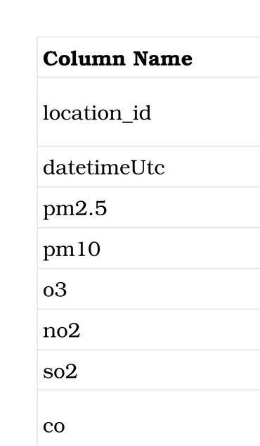
DATASET OVERVIEW : AIR QUALITY MONITORING DATA
The dataset is a time-series environmental dataset that captures atmospheric conditions and pollution levels across timestamps and locations. It includes key air pollutants and meteorological factors that directly influence the Air Quality Index (AQI).

Slide 7

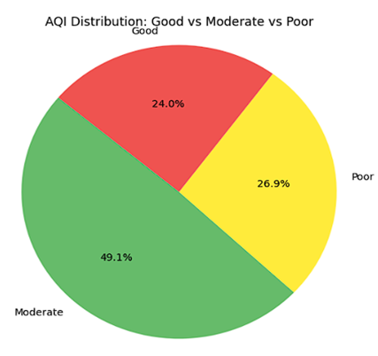
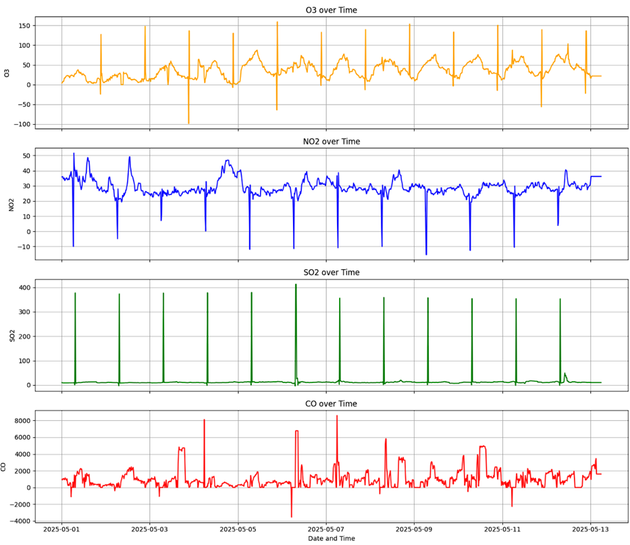
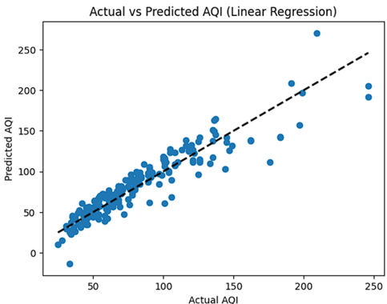
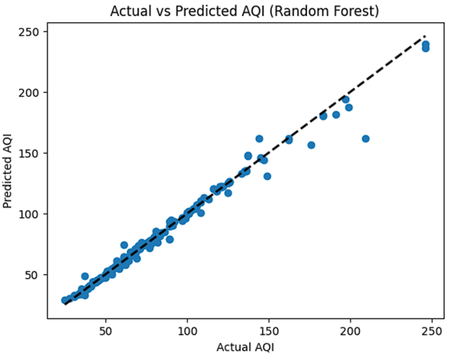
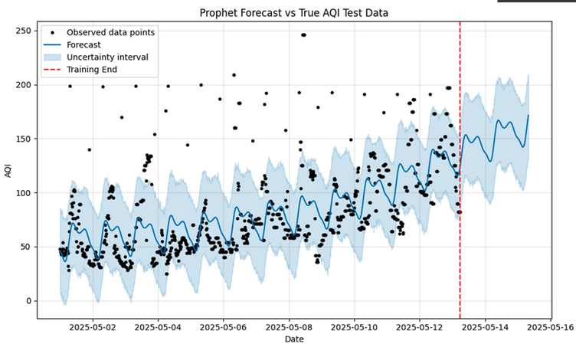
Every small action matters
Protect Our Planet
PAI CHART AQI Distribution — Good vs Moderate vs Poor
Time Series Analysis: O₃, NO₂, SO₂, and CO
Scatter plot you provided shows Actual vs Predicted AQI
Prophet Forecast: Future AQI Predictions
Prophet Forecast vs True AQI Test Data

Slide 8
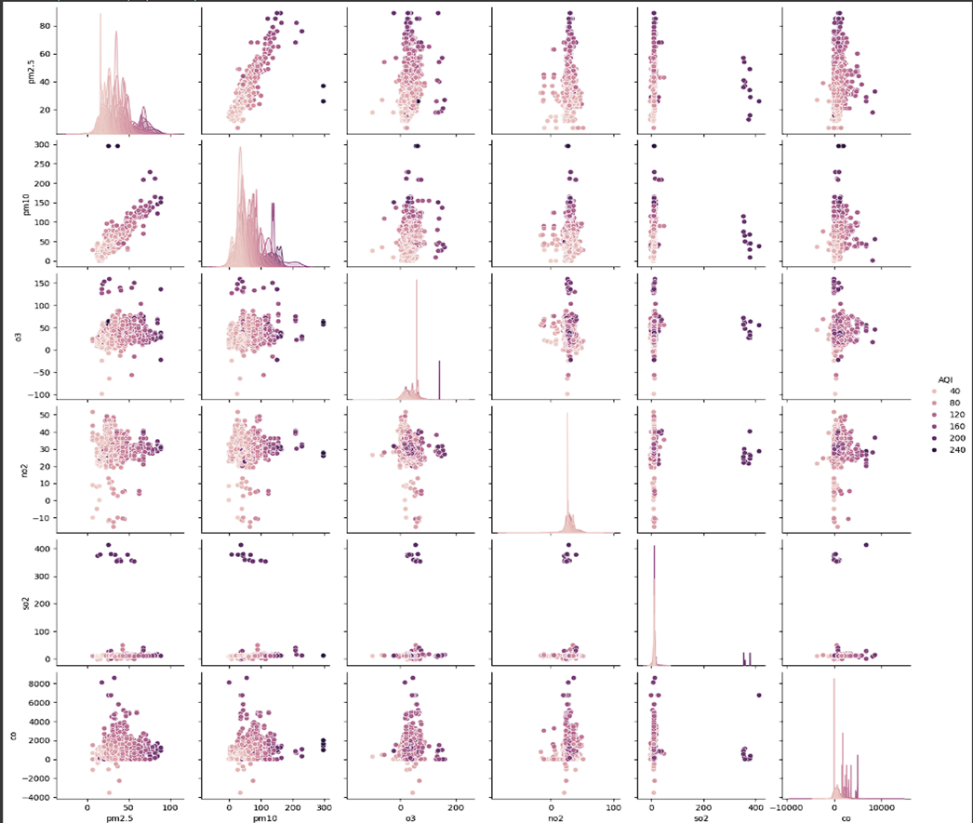
Multivariate Pairplot of Air Quality Indicators
The pairplot shown provides a multivariate correlation analysis between key air pollutants
PM2.5, PM10, O₃, NO₂, SO₂, CO with the Air Quality Index (AQI) represented by color intensity.
The pairplot helps identify how strongly different air quality variables are related to each other and how they relate to the Air Quality Index (AQI) (shown by color intensity).
How the Pairplot Helps in AQI Analysis
Identifying Key Pollutant Relationships with AQI
The color hue in the pairplot represents AQI levels.
By observing which pollutants show darker color points at higher values, we can identify which pollutants influence AQI the most.
For example:
PM2.5 and PM10 show strong correlation with AQI higher values are associated with poor air quality.
This helps in feature selection when building predictive models.

Slide 9
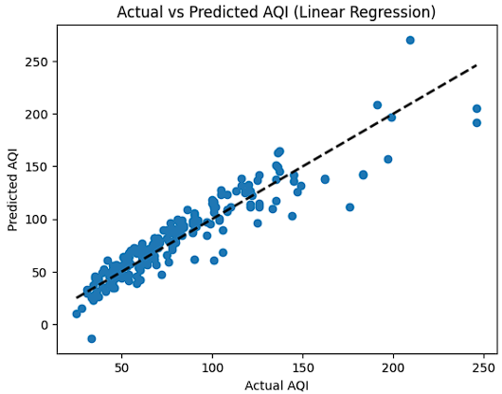

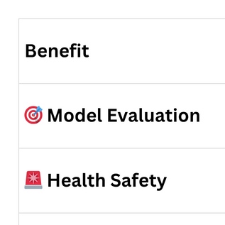
ACTUAL VS PREDICTED AQI (LINEAR REGRESSION)
This scatter plot shows the performance of a Linear Regression model in predicting Air Quality Index (AQI) based on pollutant and weather data.
The x-axis shows the actual AQI (real values from the dataset).
The y-axis shows the predicted AQI (what the model predicted).
Ideally, if predictions are perfect, all dots would lie exactly on the dashed black line.

Slide 10

Actual vs Predicted AQI (Random Forest)
This plot visually compares the actual Air Quality Index (AQI) values with the predicted AQI values generated by a Random Forest Regressor model. It’s a key tool for evaluating model accuracy and reliability in air quality forecasting.
X-axis: Actual AQI values (true values from the dataset).
Y-axis: Predicted AQI values (from the model).
Blue dots: Individual predictions by the model.
Dashed line: Ideal scenario (perfect prediction)
Usage of the Random Forest AQI Prediction Plot
This plot is used to visually assess how accurately the Random Forest model predicts AQI values.
predicted values align closely with actual ones,
This is crucial before deploying the model in a real-world air monitoring system.
Air Quality Forecasting
Public Health Alerts
Urban and Environmental Planning

Slide 11

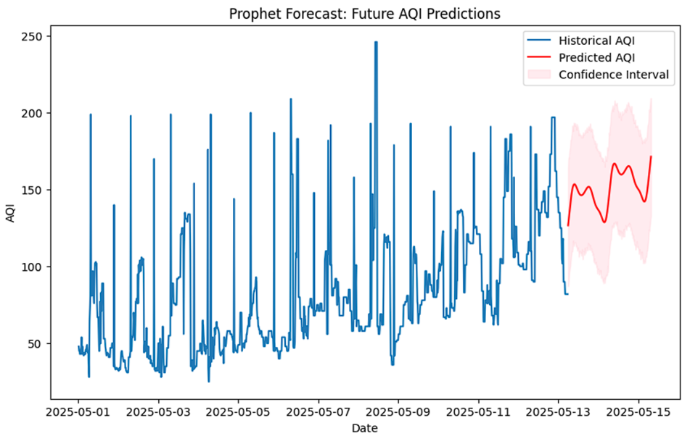
Prophet Forecast: Future AQI Predictions
Time series plot visualizes the forecasted Air Quality Index (AQI) values using
Blue Line: Historical AQI data (actual measurements up to May 12, 2025).
Red Line: Forecasted AQI values (from May 12 to May 15, 2025).
Shaded Pink Area: Confidence interval (range within which the true AQI is likely to fall, with 95% probability).
Why It's Important
Accurate short-term forecasting of air quality
Helps in early health alerts for poor air days
Useful for policy planning and pollution control
Provides uncertainty range to prepare for worst-case scenarios

Slide 12
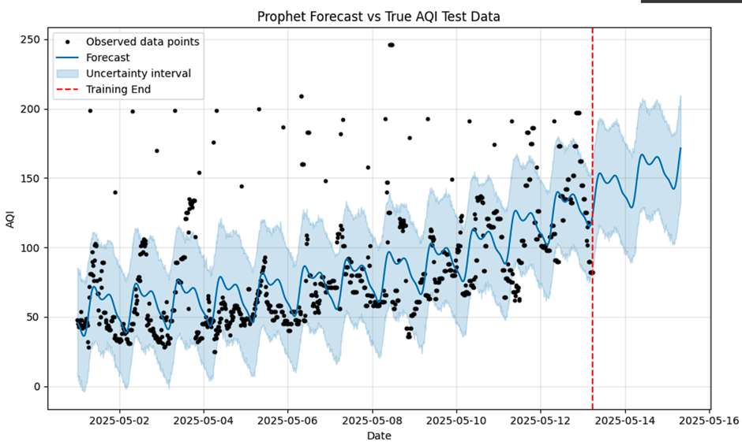
Prophet Forecast vs True AQI Test Data
Black Dots: Actual observed AQI values
Blue Line: Prophet model’s forecast
Shaded Area: Prediction uncertainty range
Red Line: End of training data (forecast starts after this)
Helps assess the accuracy and reliability of the forecast model.
The forecast captures overall trends
The uncertainty interval helps manage risk in decisions based on the predictions.
Useful in environmental planning, public health alerts, and pollution control strategies

Slide 13


POLLUTANTS OVER TIME
time series plots for four major air pollutants:
O₃ (Ozone) – 🟧 Orange
NO₂ (Nitrogen Dioxide) – 🔵 Blue
SO₂ (Sulfur Dioxide) – 🟢 Green
CO (Carbon Monoxide) – 🔴 Red
Ozone (O₃) is like the sun’s shadow—it follows a daily rising and falling smoothly, mostly reacting to sunlight during the day.
NO₂ (Nitrogen Dioxide) behaves like traffic—it stays steady but dips suddenly, when traffic slows
SO₂ (Sulfur Dioxide) is quiet most of the time, but occasionally bursts loudly—likely from industrial emissions or power plants firing up.
CO (Carbon Monoxide) is unpredictable
spiking up and down like a wild heartbeat, possibly from vehicles, burning trash, or cooking fires.

Slide 14

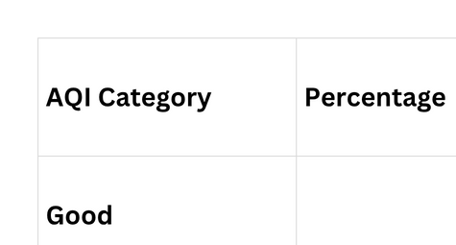
PAI CHART AQI DISTRIBUTION GOOD VS MODERATE VS POOR

Slide 15






EARTH IS OUR COMMON HOME
INSIGHT:
CONTROLLING PM2.5 AND PM10 CAN HAVE THE MOST SIGNIFICANT IMPACT ON IMPROVING AQI.
RANDOM FOREST IS THE BEST-PERFORMING MODEL FOR AQI PREDICTION IN THIS SCENARIO
LINEAR REGRESSION IS SUITABLE FOR BASIC TREND ANALYSIS, BUT NOT FOR PRECISE AQI PREDICTION, ESPECIALLY DURING POLLUTION SPIKES
PROPHET IS VALUABLE FOR EARLY WARNINGS AND PROACTIVE ENVIRONMENTAL PLANNING.
TIME-BASED VISUALIZATIONS HELP IN IDENTIFYING POLLUTION SOURCES AND TIMING, AIDING REGULATORY ACTION.

Slide 16
CONCLUSION
THE PROJECT SUCCESSFULLY DEMONSTRATES A COMPREHENSIVE APPROACH TO AIR QUALITY ANALYSIS AND FORECASTING. BY APPLYING LINEAR REGRESSION AND RANDOM FOREST, IT PREDICTS AQI WITH REASONABLE ACCURACY. THE INTEGRATION OF PROPHET ENABLES SHORT-TERM AQI FORECASTING, WHILE VISUALIZATIONS LIKE PAIRPLOTS, TIME SERIES GRAPHS, AND PIE CHARTS HELP INTERPRET POLLUTANT TRENDS AND AQI CATEGORIES EFFECTIVELY. OVERALL, THIS WORKFLOW PROVIDES A SOLID FOUNDATION FOR DATA-DRIVEN ENVIRONMENTAL MONITORING AND DECISION-MAKING.

Slide 17


Thanks YOU

